Slide 1

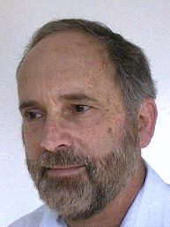
LiMoSense –
Live Monitoring in Dynamic Sensor Networks
Ittay Eyal, Idit Keidar, Raphi Rom
Technion, Israel
Israeli Networking Day. March 2011

Slide 2
Outline
Background – static average aggregation in sensor networks.
LiMoSense.
Correctness.
Convergence.
Dynamic behavior.

Slide 3
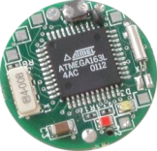
Sensors
Read values and communicate.
Light-weight, little energy, error prone.

Slide 4
Sensor Network
Many sensors (at least thousands).
Limited topology.
Similar scenario in cloud monitoring

Slide 5
Average Aggregation
Target: Average of read values.
Reason:
Environmental monitoring.
Cloud computing load monitoring.
Challenge: Cannot collect the values.
Solution: In-network aggregation.
Hierarchical solution?
Not robust.

Slide 6
Static error-free aggregation [1,2]
Bidirectional communication gossip
8
5
5
3
3
4
2
5
4
t=1
t=2
t=3
D. Kempe, A. Dobra, and J. Gehrke. Gossip-based computation of aggregate information. In FOCS, 2003.
S. Nath, P. B. Gibbons, S. Seshan, and Z. R. Anderson. Synopsis diffusion for robust aggregation in sensor networks. In SenSys, 2004.

Slide 7
Static error-free aggregation [1,2]
Unidirectional communication gossip
v
w
Send half:
A
3, 1
3, 0.5
(3, 0.5)
B
5, 1
4.3, 1.5
D. Kempe, A. Dobra, and J. Gehrke. Gossip-based computation of aggregate information. In FOCS, 2003.
S. Nath, P. B. Gibbons, S. Seshan, and Z. R. Anderson. Synopsis diffusion for robust aggregation in sensor networks. In SenSys, 2004.

Slide 8
Static error-free aggregation [1,2]
Unidirectional communication gossip
v
w
A
3, 1
4, x
(3, 0.5)
B
5, 1
4, y
D. Kempe, A. Dobra, and J. Gehrke. Gossip-based computation of aggregate information. In FOCS, 2003.
S. Nath, P. B. Gibbons, S. Seshan, and Z. R. Anderson. Synopsis diffusion for robust aggregation in sensor networks. In SenSys, 2004.

Slide 9
Static error-free aggregation
Realistic?
Monitoring → Dynamic input! (restart?)
Cheap sensors → Crashes.
Limited battery →
Link failure and message loss

Slide 10
LiMoSense –
Live Monitoring in Dynamic Sensor Networks

Slide 11
Live error-free aggregation
Observation: Invariant:
read sum = Weighted sum
A
3, 1
3, 1/2
B
5, 1
4.3, 3/2

Slide 12
Live error-free aggregation
Observation: Invariant:
read sum = Weighted sum
Goal: Maintain the invariant after input changes.

Slide 13
Live error-free aggregation
Each node stores:
Current weighted value.
Previously read value.
On read change: update weighted value to fix invariant.
Weight unchanged.

Slide 14
Live error-free aggregation
Example: read value 0 → 1
3, 1
4, 1
Case 1:
3, 2
3.5, 2
Case 2:
Before
After

Slide 15
Live robust aggregation
Lost messages → lost weight → broken Invariant:
3, 1
3, 0.5
(3, 0.5)
(3, 0.25)

Slide 16
Live robust aggregation
Solution: Send summary, not diff:
3, 1
3, 0.5
3, 1
3, 0.5
(3, 0.5)
(3, 0.5)
(3, 0.25)
(3, 0.75)

Slide 17
Live robust aggregation
Solution: Send summary, not diff:
Lost message:
Fix on next one.
Failed link:
Transfer undo.
3, 1
3, 0.5
(3, 0.5)
(3, 0.75)

Slide 18
Live robust aggregation
Solution: Send summary, not diff:
3, 1
3, 0.5
3, 0.25
3, 1
(3, 0.5)
(3, 0.75)
Undo
Link
fail

Slide 19
Live robust aggregation
Challenge: weight → infinity
Solution:
Hybrid push-pull:
Ask neighbor to send
back inverse.
3, 1
3, 0.5
(3, 0.5)
(3, 0.75)

Slide 20
Live robust aggregation
Challenge: weight → infinity
Solution:
Hybrid push-pull:
Ask neighbor to send
back inverse.
3, 1
3, 0.5
pull
(3, -0.5)
(3, 0.5)

Slide 21
Live robust aggregation
Crashed node → lost links.

Slide 22
Correctness

Slide 23
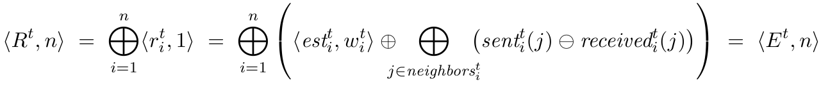
Correctness - Safety
Theorem 1: The invariant always holds.
On message send/receive.
After value change.
After add/remove neighbor.
After node removal/addition.

Slide 24
Correctness - Liveness
Theorem 2: After GST, all estimations converge to the average.
Quantization constant and fairness.
Value propagation.
Convergence.

Slide 25
Correctness - Liveness
1. Quantization constant and fairness.
Weight is transferred in multiples of q.
Note – This does not effect accuracy.
Each node eventually succeeds to send a push message to all of its neighbors.

Slide 26
Correctness - Liveness
2. Value propagation.
Lemma:
For any time t >= GST and node i, there exists a time t’ > t after which every node j has a component of i with a weight larger than some bound (the bound is dependent on n and q)

Slide 27


Slide 28
Correctness - Liveness
3. Convergence.
Define a series GST =t₀, t₁, t₂, ...
Where at t_{i} each node has a bounded-from-below portion from each node
at t_{i-1}.
At each t_{i}, the largest error is smaller than in t_{i-1}, because it's mixed with other values.

Slide 29
Convergence Rate

Slide 30
Convergence
Static convergence rate (exchange gossip):
Static input (after GST).
Dense topology.
Synchronous uniform runs.

Slide 31
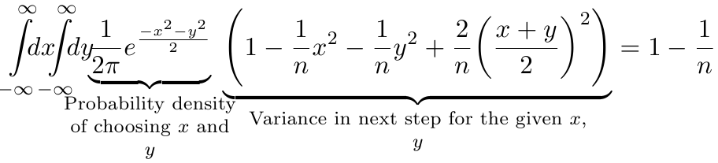
Convergence
Static convergence rate (exchange gossip):
Assumption:
normal distribution of estimations.

Slide 32
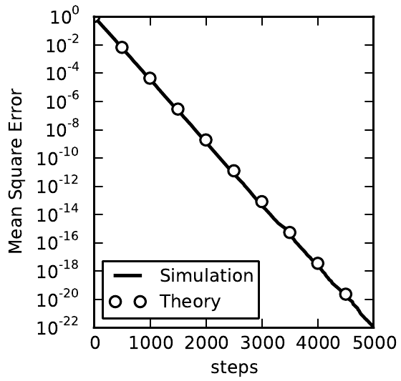
Convergence
Static convergence rate (exchange gossip):

Slide 33
Simulation

Slide 34
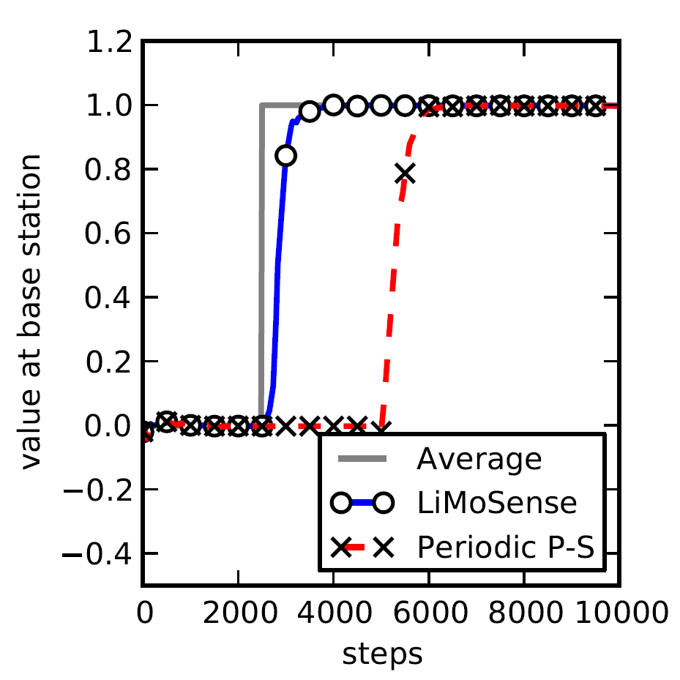
Step Function
100 nodes.
Standard Normal
distribution
10 nodes change
Values (+10)

Slide 35
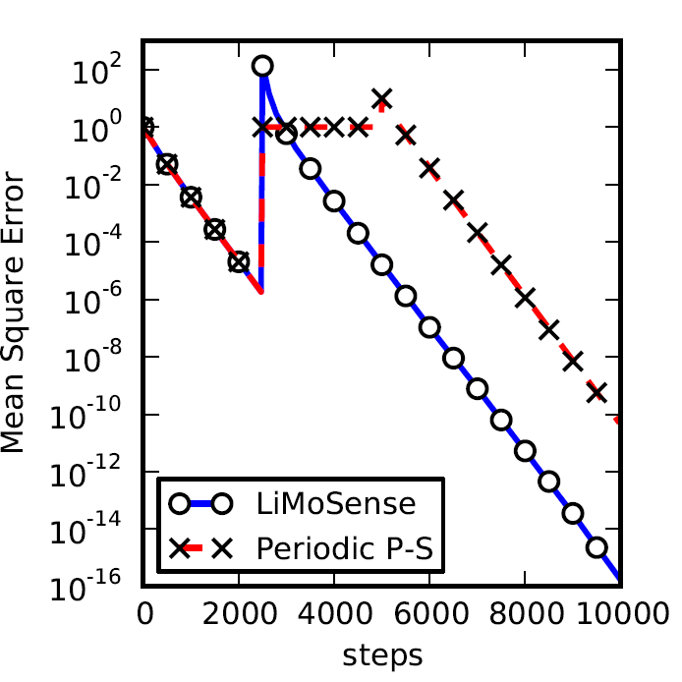
Step Function
100 nodes.
Standard Normal
distribution
10 nodes change
Values (+10)

Slide 36
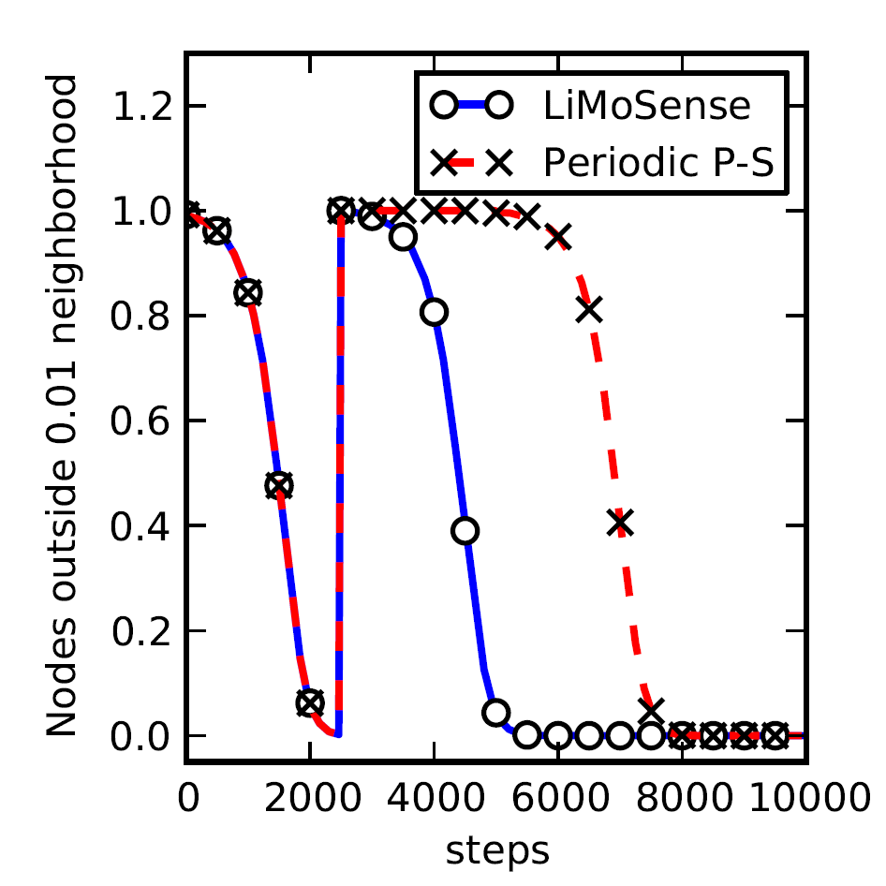
Step Function
100 nodes.
Standard Normal
distribution
10 nodes change
Values (+10)

Slide 37
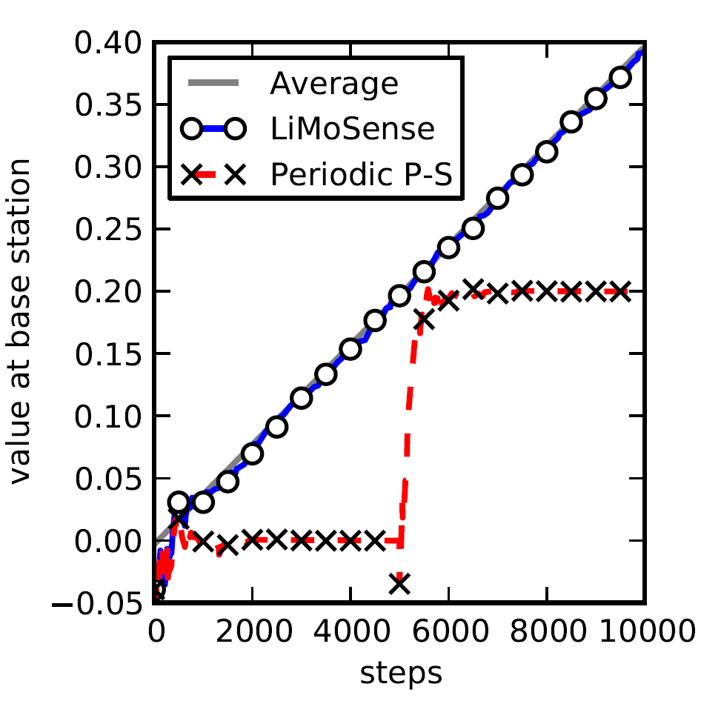
Creeping Value Change
100 nodes.
Standard Normal
distribution
Every 10 steps, 10 nodes change
Values (+0.01)

Slide 38
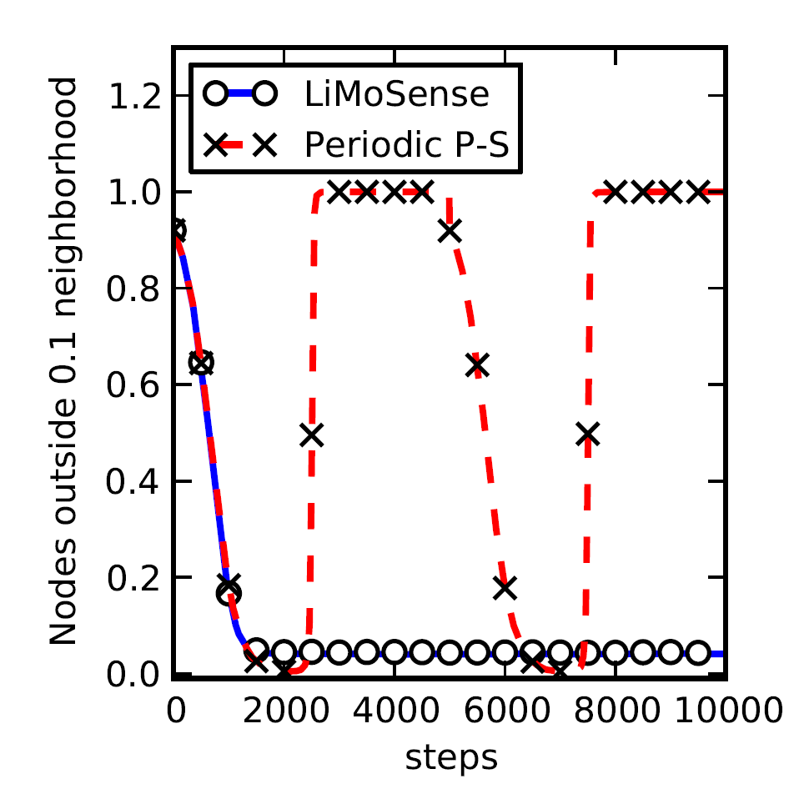
Creeping Value Change
100 nodes.
Standard Normal
distribution
Every 10 steps, 10 nodes change
Values (+0.01)

Slide 39
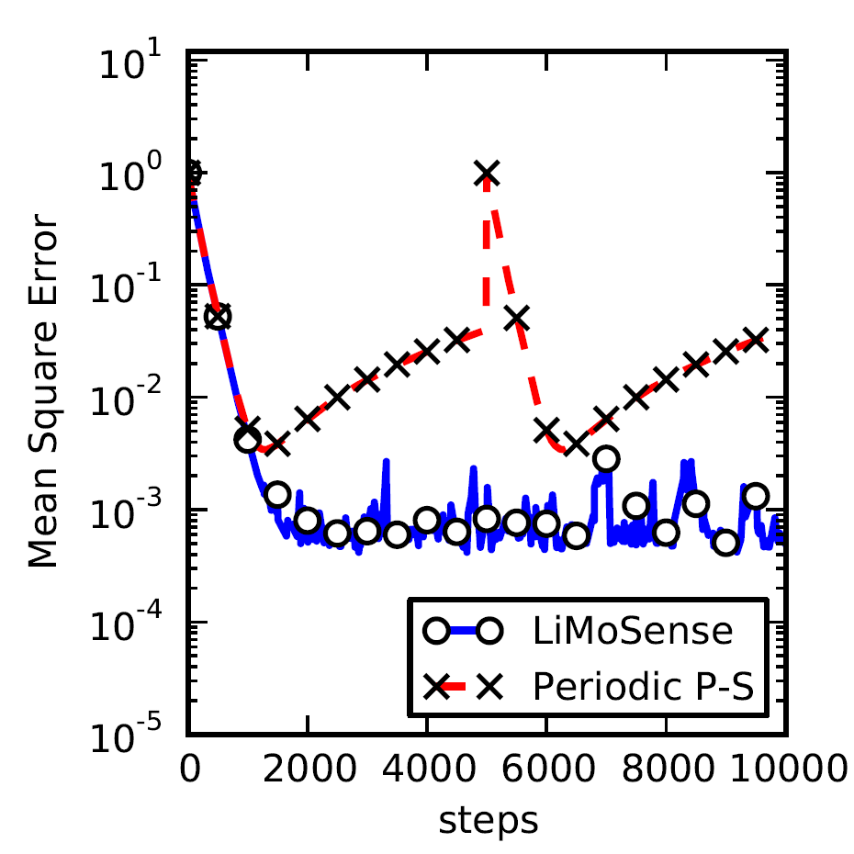
Creeping Value Change
100 nodes.
Standard Normal
distribution
Every 10 steps, 10 nodes change
Values (+0.01)

Slide 40
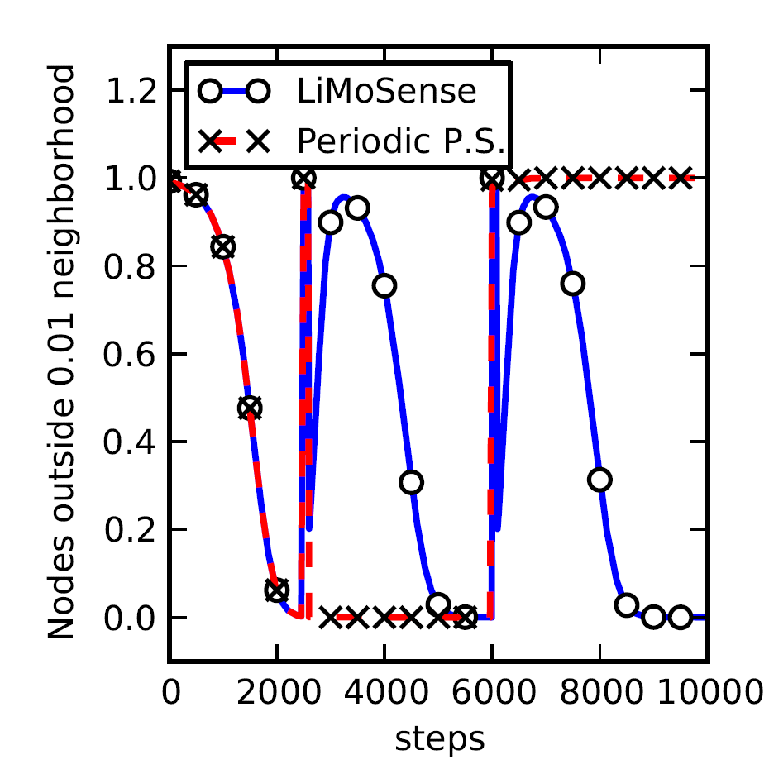
Response to Step Function
100 nodes.
Standard Normal
distribution
10 nodes change Values (+10) for 100 steps

Slide 41
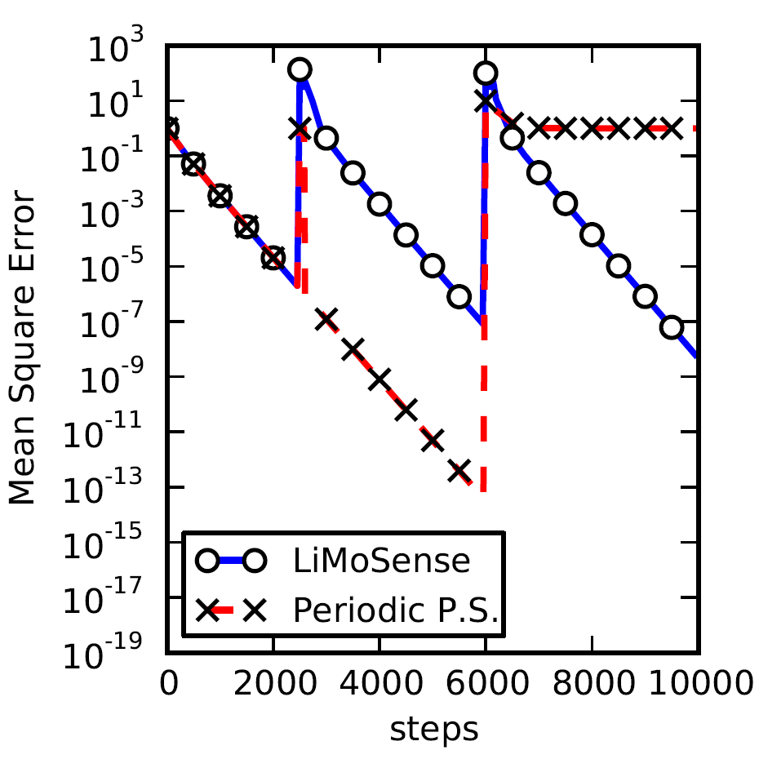
Response to Step Function
100 nodes.
Standard Normal
distribution
10 nodes change Values (+10) for 100 steps

Slide 42
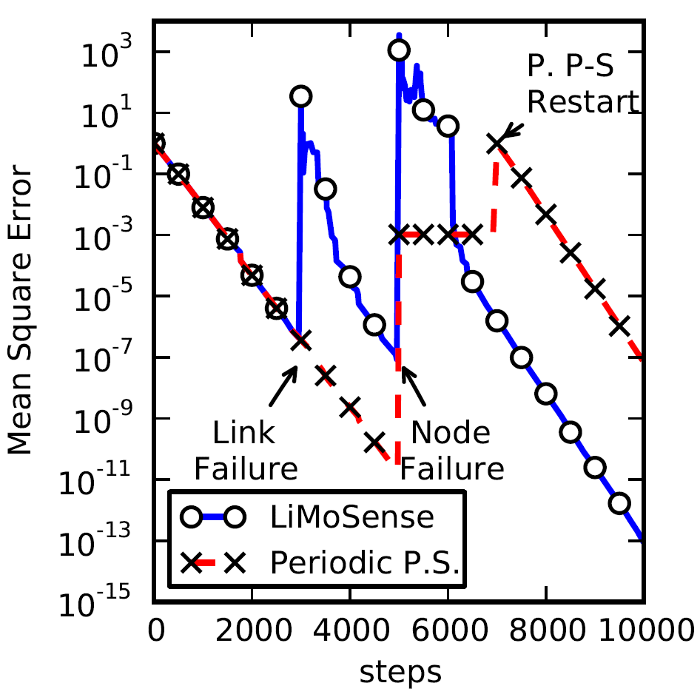
Dynamic Network
Disc Graph
t=2500: 10 nodes
range decay, 7 lost links
t=5000:
Node crash.

Slide 43
Summary
LiMoSense – Live Average Monitoring in error prone dynamic sensor networks.
Live: aggregate dynamic data reads.
Fault tolerant: Message loss, link failure and node crash.
Correctness in dynamic asynchronous settings.
Exponential convergence after GST.
Quick dynamic behavior.
Ittay Eyal, Idit Keidar, Raphael Rom. LiMoSense - Live Monitoring in Dynamic Sensor Networks, Technion technical report CCIT #786 March 2011EE.

Slide 44
Good Questions

Slide 45
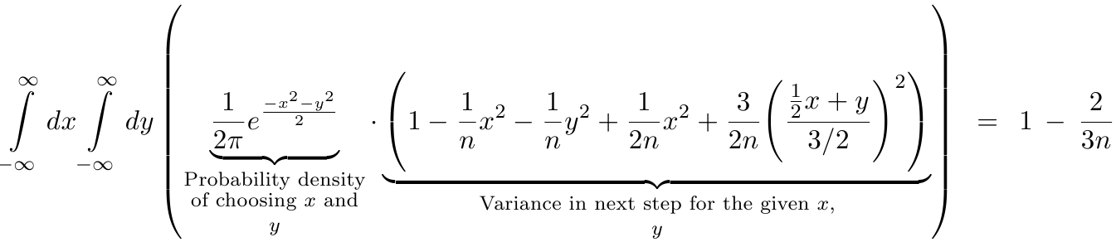
Convergence
Static convergence rate (push gossip):

